Slide 1

Online Book Search using Web Service
Sudhaanva Hukkeri (10383120)

Slide 2
Introduction
It’s a book search repository
Search of books by text
Here I am using Google book API end point

Slide 3
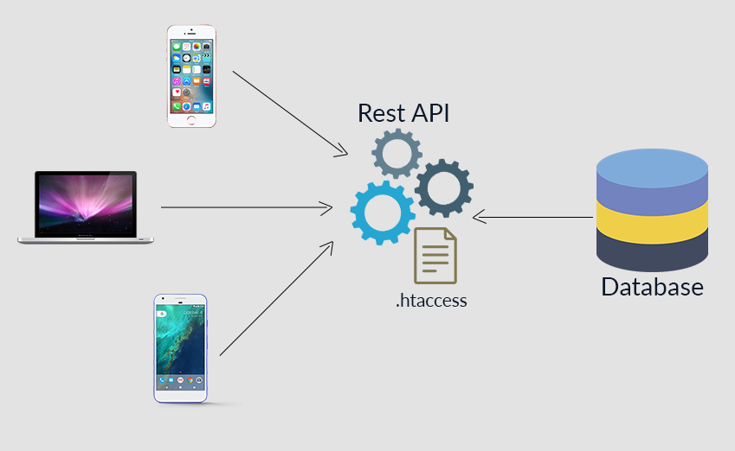

Introduction

Slide 4
Challenges and Difficulties
The main challenging part was to find the RESTful API web services for the book repository.
The API allows requesting information on one or more books using ISBNs only Ex
Goodreads API
Penguin Random House
Open Library

Slide 5
Challenges and Difficulties
But fortunately Google Books allows API requesting using TITLE text of the book.
And the authentication is also less for to just get the Book data.

Slide 6
Pros and cons of the application
Pros
You are able to find rare and out-of-print books because of the repository is big.
You can search using simple text
Cons
I was not able to list the Book or sort them by genera or rating.

Slide 7
To the working part of the application.
https://sudhush.github.io/EISApp10383120/

Slide 8
THANK YOU

